Slide 1
URBAN ENVIRONMENTAL STRESS AND BEHAVIORAL ADAPTATION
2023
A CASE STUDY ON BHOPAL CITY, INDIA

Slide 2
CONTENT
INTRODUCTION
OVERVIEW OF BHOPAL CITY
UNDERSTANDING URBAN STRESS
BEHAVIORAL ADAPTATION TO URBAN STRESS
FACTORS INFLUENCING BEHAVIORAL ADAPTATION
IMPLICATIONS FOR URBAN PLANNING AND POLICY MAKING
RECOMMENDATIONS
CONCLUSION

Slide 3
INTRODUCTION
Environmental stressors refer to aspects of one's surroundings that increase mental or emotional strain in their life.
There are many different potential causes of environmental stress. These causes include extreme temperatures, loud noises, large crowds, war, crime, and pollution.
Short durations of stress can be beneficial, but large amounts of long-lasting stress can be potentially harmful to a person's health.
What are Environmental stressors?

Slide 4
An Overview of Bhopal City
Bhopal is a captivating city situated in the heart of India. It serves as the capital of the state of Madhya Pradesh
Its economy thrives in various sectors, including manufacturing and traditional arts and crafts. The city is known for its educational institutions, attracting students and professionals from different regions.
Geographically, Bhopal is located in the central part of the country, with the beautiful Vindhya Range and Malwa Plateau encompassing its landscape.
As for its population, Bhopal is home to a diverse community, and its population size has grown significantly over the years. As at September 2021, the city had an estimated population of around 1.8 million people.
As urbanization has accelerated, Bhopal faces challenges like strained infrastructure, traffic congestion, and encroachment on green spaces, impacting biodiversity and exacerbating heat. Despite these challenges, Bhopal's rich history, vibrant culture, and scenic surroundings make it a unique blend of traditional and modern experiences.

Slide 5
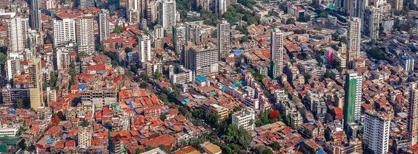
BHOPAL CITY, India

Slide 6
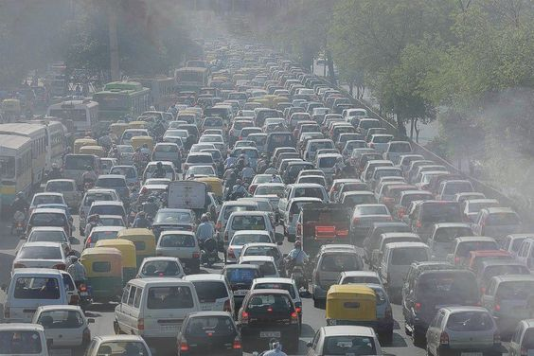
Environmental Issues in the City of Bhopal
Environmental Issues
The environmental issues in the city of Bhopal include;
Air pollution
Water pollution
Traffic congestion
Noise pollution
Fig. 2 Traffic jam on Bhopal roads

Slide 7
Research Results
Problems in Bhopal City
Describing the city environment of Bhopal, various environmental situations were taken into account like traffic congestion, vehicular emission, congested habitat, expansion in slums, and others which indicated various problems that the citizens residing in Bhopal were experiencing.
Figure 1. Major Problems in Bhopal City

Slide 8
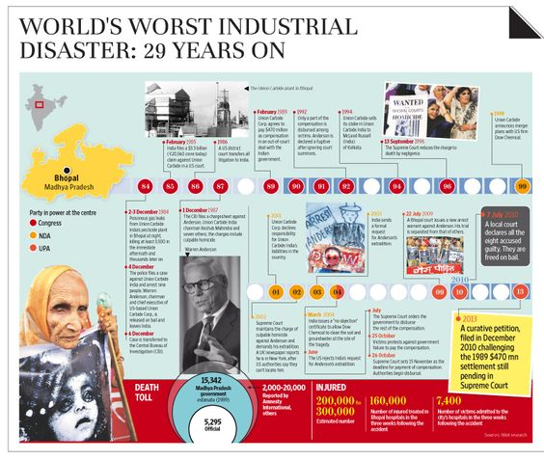
The Bhopal Gas Tragedy
On December 3, 1984, about 45 tons of the dangerous gas methyl isocyanate escaped from an insecticide plant that was owned by the Indian subsidiary of the American firm Union Carbide Corporation. The gas drifted over the densely populated neighborhoods around the plant, killing thousands of people immediately and creating a panic as tens of thousands of others attempted to flee Bhopal. The final death toll was estimated to be between 15,000 and 20,000. Some half a million survivors suffered respiratory problems, eye irritation or blindness, and other maladies resulting from exposure to the toxic gas.

Slide 9
Behavioral Adaptation
Various ways by which individuals and communities can respond and adjust their behaviors in various ways to cope with environmental challenges
Waste Reduction and Recycling
2. Conservation and Resource Management
3. Environmental Education and Awareness

Slide 10
Factors Influencing Behavioral Adaptation in Urban Environments
Key factors that influence the adoption of behavioral adaptation strategies:
Socio-economic Status
Educational Level
Access to Information and Resources
Government Policies and Initiatives

Slide 11
Examples of behavioral adaptations observed in other urban centers
Tokyo, Japan (Waste Management): Tokyo has a comprehensive waste management system, with residents actively participating in waste separation and recycling
3. Singapore (Water Management): Singapore faces water scarcity due to limited natural resources. As a behavioral adaptation, the city has implemented water conservation and recycling programs. Residents use water-saving appliances and adopt rainwater harvesting to reduce water consumption.
2. Seoul, South Korea (Air Quality): Seoul faces air pollution from industrial activities and traffic. As an adaptation, the city has implemented car-free days and encourages citizens to use public transportation or electric vehicles to reduce emissions.

Slide 12
Recommendations
City planners should prioritize creating more green spaces, like parks and rooftop gardens, to offset the heat island effect and improve the well-being of Bhopal's residents.
To tackle air pollution, promoting eco-friendly transportation alternatives and implementing stringent emissions standards for industries are crucial steps.
Additionally, adopting cleaner energy sources can make a significant difference.
Community involvement is also vital. Initiatives such as awareness campaigns and educational programs can empower individuals to embrace sustainable practices and contribute to a cleaner environment.

Slide 13
Conclusion
The study on "Urban Environmental Stress and Behavioral Adaptation in Bhopal City, India" highlights the environmental challenges faced by rapidly growing urban centers. Bhopal City, like others, deals with issues such as air and water pollution, noise, and waste management. Residents showed awareness of these stressors and exhibited significant behavioral adaptations to address them. However, factors like socioeconomic status, education level, and access to resources influenced the extent of adaptation. The research emphasizes the need to integrate environmental concerns into urban planning for sustainable development. Collaboration among stakeholders, including governments, NGOs, and residents, is vital in fostering adaptive behaviors. The goal is to create resilient and livable urban environments that prioritize the well-being of current and future generations while preserving natural resources and ecosystems.

Slide 14
References
[1] A. de Sherbinin, “The role of sustainability indicators as a tool for assessing territorial environmental competitiveness,” in Presented at the International Forum for Rural Development, pp. 1–16, Brasilia, Brazil, November 2003.
[2] K.Lewin,FieldTheoryinSocialScience,Harper,NewYork,NY, USA, 1951.
[3] J. Campbell, “Ambient stressors,” Environment and Behavior, vol. 15, pp. 55–380, 1983.
[4] R.G.Barker,Concepts&MethodsforStudyingtheEnvironment of Human Behaviour, Ecological Psychology, Stanford Univer- sity Press, Stanford, Calif, USA, 1968.
[5] F. Berkes and C. Folke, Eds., Linking Sociological and Ecological Systems: Management Practices and Social Mechanisms for Building Resilience, Cambridge University Press, New York, NY, USA, 1998.
[6] R. Haeuber and P. Ringold, “Ecology, the social sciences and environmental policy,” Ecological Applications, vol. 8, no. 2, pp. 330–331, 1998.
[7] M. Pacione, “Urban environmental quality and human wellbeing—a social geographical perspective,” Landscape and Urban Planning, vol. 65, no. 1-2, pp. 19–30, 2003.
[8] G. Costa, L. Pickup, and V. Di Martino, “Commuting—a further stress factor for working people: evidence from the European Community. II. An empirical study,” International Archives of Occupational & Environmental Health, vol. 60, no. 5, pp. 377–385, 1988.

Slide 15
THANK YOU!
2023

